Slide 1


Smart India Hackathon 2019
PROJECT SARVIK
MANIPAL

Slide 2
Idea and Approach

Slide 3
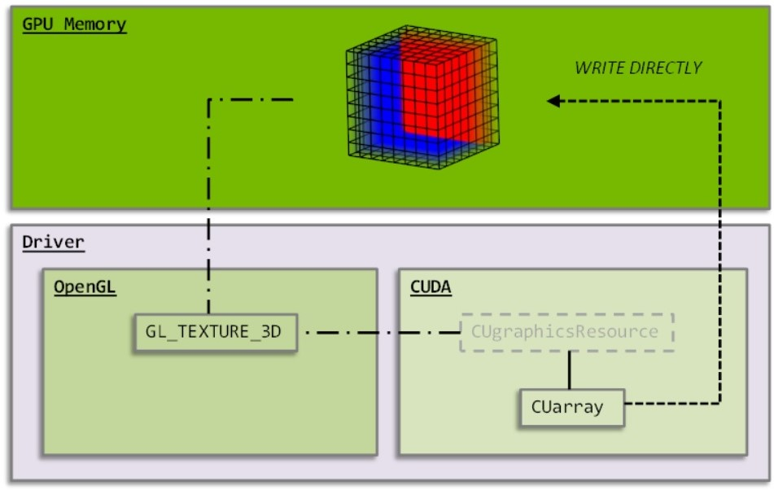

Slide 4
Point Source

Slide 5
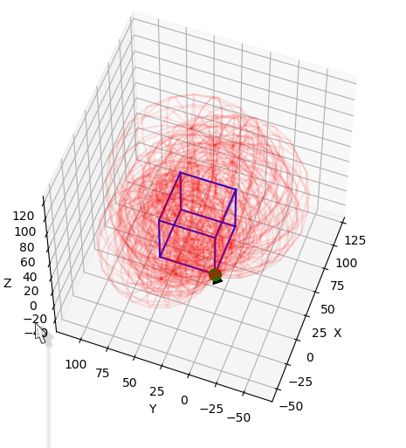

Slide 6
Line Source

Slide 7
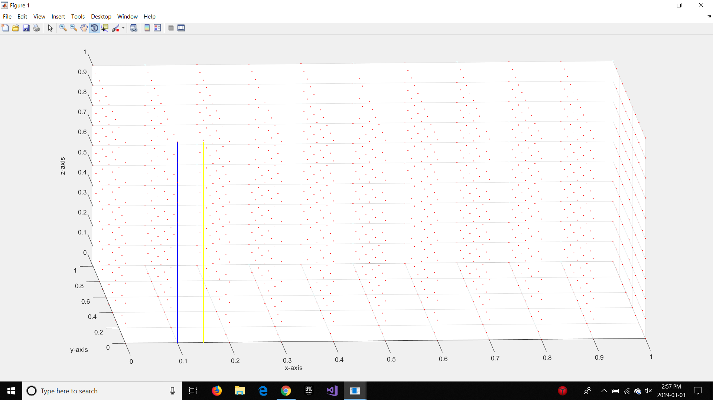
Location of both Line Sources

Slide 8
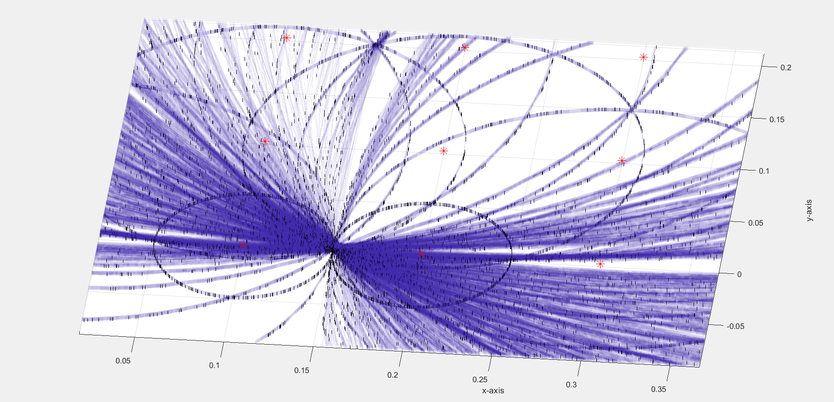
Location in Plot

Slide 9
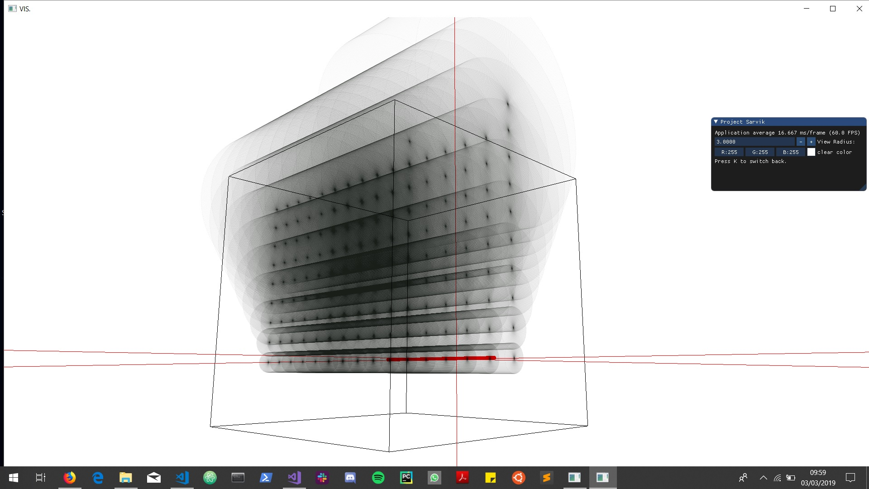
Visualisation in OpenGL+Cuda

Slide 10
Plane Source

Slide 11
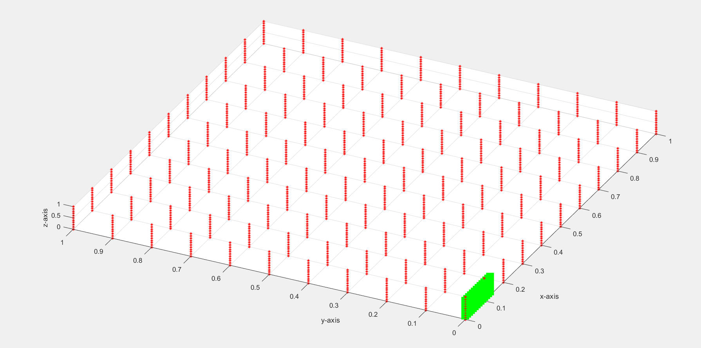
Location of Plane Source

Slide 12
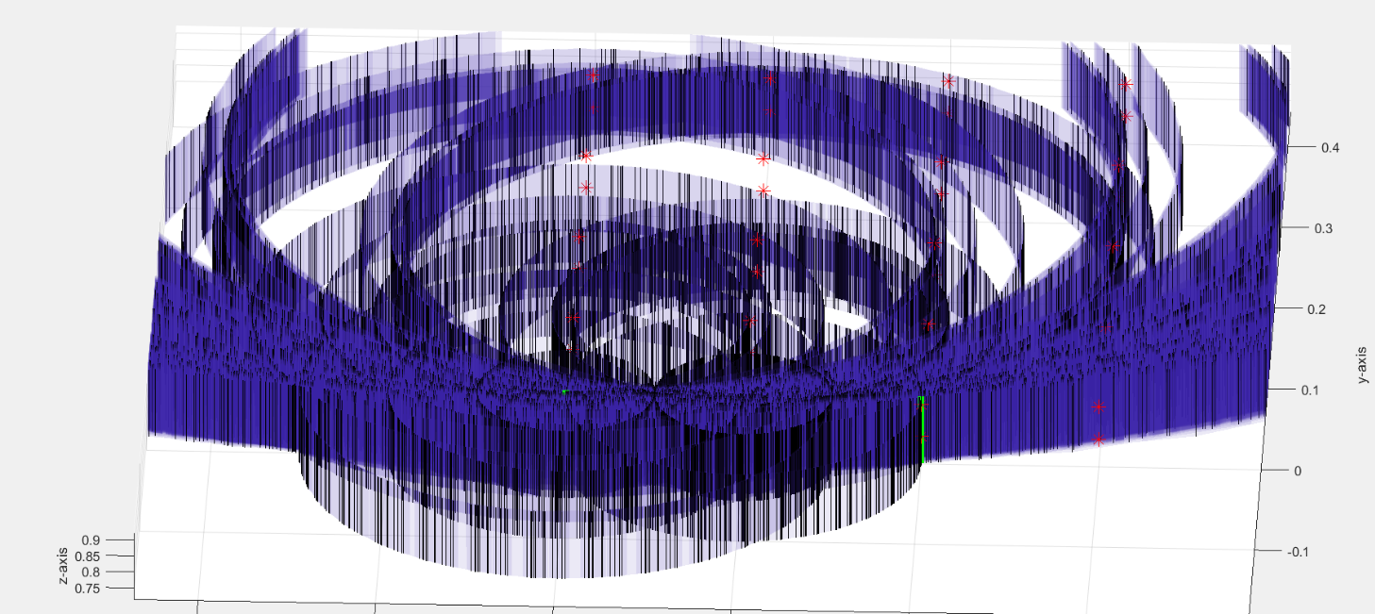
Location in Plot

Slide 13
3D Source

Slide 14
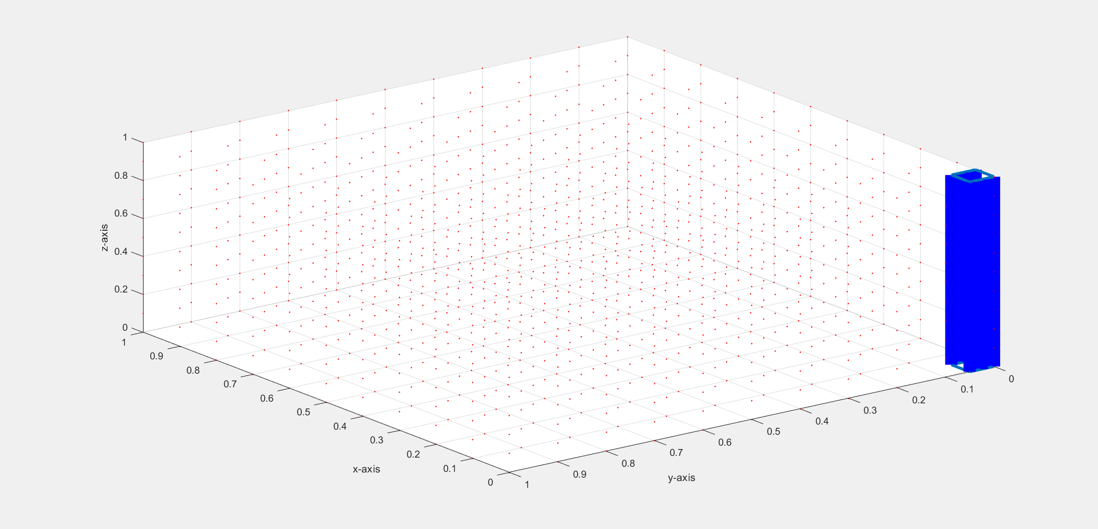
Location of 3D Source

Slide 15
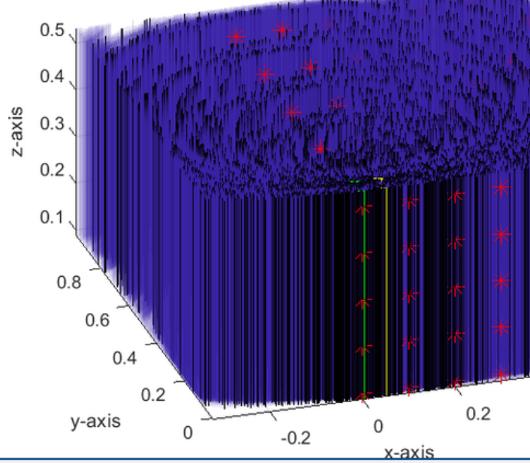
Location in the Plot

Slide 16
OpenGL+Cuda vs other Visualisation Libraries
Parallel Vertex Buffer initialisation
Simultaneous rendering of multiple objects

Slide 17
OpenGL+Cuda Matlab
Computation Time
14s
Memory Utilization
54%
CPU and GPU utilization
CPU-44%
GPU-44%
Computation Time
244s
Memory Utilization
56%
CPU and GPU utilization
CPU-56%
GPU-0%

